Slide 1
Project 3
Room, Revenue and Rate
Sujita Kapali
07-27-2019

Slide 2
Table of Contents:
Introduction
Description
Locations and Competitors
Composition of Market Segments
Data Sources
Analysis of Data
Methodologies
Challenges and Limitations
Conclusion

Slide 3
Introduction
Title – Room , Rate and Revenue
Purpose of the study – Forecast rooms and plug rates to maximize room revenue
Assumptions – Demand , Supply and Room type.

Slide 4
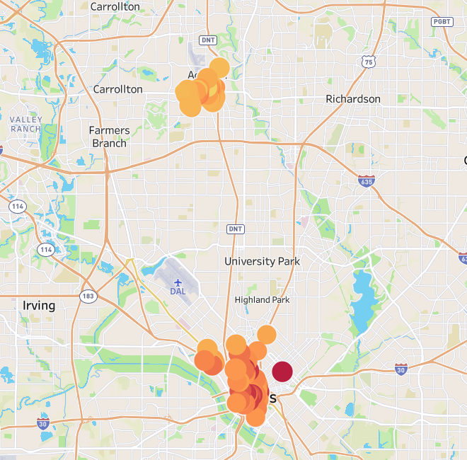
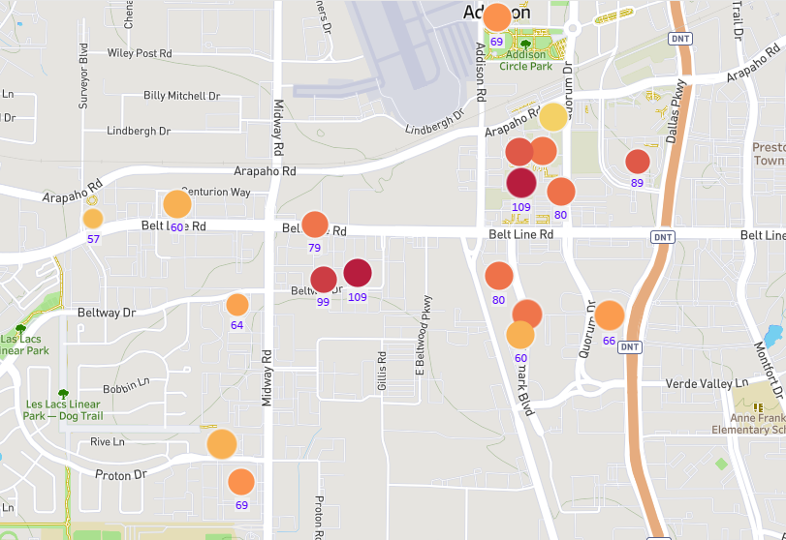
Hotel – Location and Competitor Rates
Addison / Dallas Addison

Slide 5
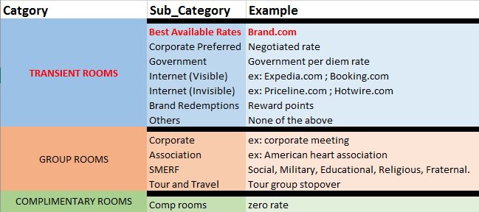
Description
Hotel for study
Competitors
Doubletree Hotel Dallas Near The Galleria
Hilton Dallas Lincoln Centre
Sheraton Dallas Hotel By The Galleria
Renaissance Dallas Addison Hotel
Westin Galleria
Crowne Plaza Dallas Near Galleria Addison
Embassy Suites Dallas Near The Galleria
Le Meridien Dallas By The Galleria
Market Segments

Slide 6
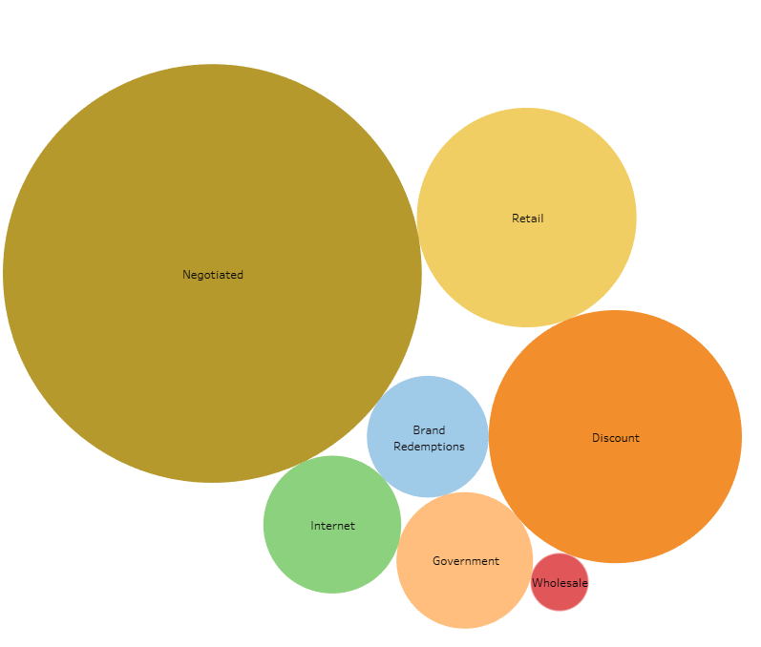
Composition of Market Segment

Slide 7
Data Sources
Transformation of proprietary data
https://www.tripadvisor.com/
https://www.hotelplanner.com/

Slide 8
Analysis of Data
Three Stages:
Exploration – Revenue ,Rooms, Rate and other features
Prediction - Rooms
Prescription – Maximize Room Revenue

Slide 9
Methodologies
Exploration: Correlation Matrix
Prediction: Regression Models and Python fbprophet
Prescription: Excel LP Solver

Slide 10
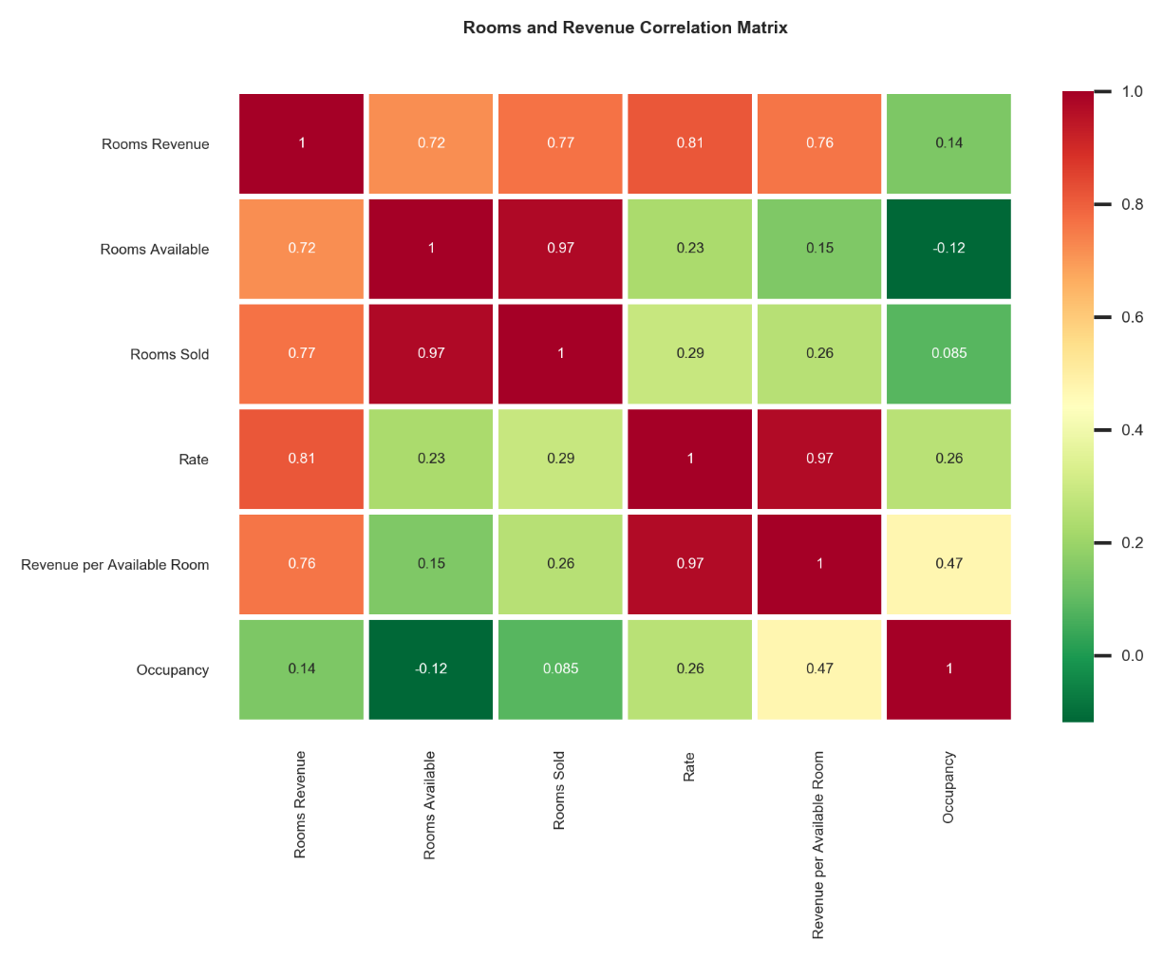
Analysis of Data - Exploration
Generalized data – not pertaining to the hotel under study
Correlation between room revenue and other features
High correlation between revenue and rooms sold / rate
Low correlation between revenue and occupancy

Slide 11
Analysis of Data – Prediction (Regression Models)
Model | Score | Result
RandomForestRegressor | 0.8867228481757251 | [(0.6204741594030869, 'rooms’), (0.37952584059691324, 'rate')]
GradientBoostingRegressor | 0.9018650858921968 | [(0.6260904097082505, 'rooms’), (0.37390959029174947, 'rate')]

Slide 12
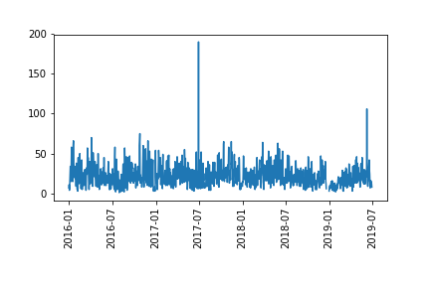
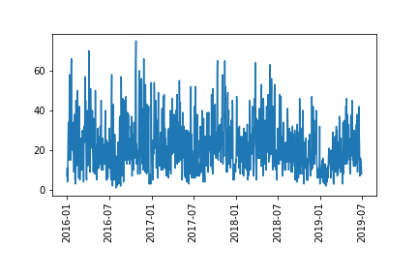
Analysis of Data – Prediction (Time Series Model)
Original Cleaned

Slide 13
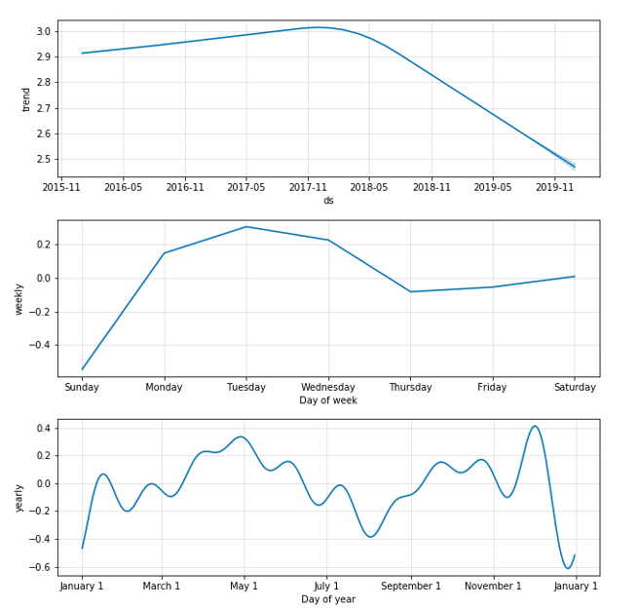
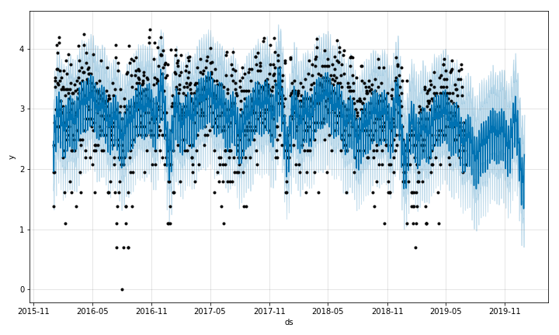
Analysis of Data – Prediction (Time Series Model)
Forecast Components

Slide 14
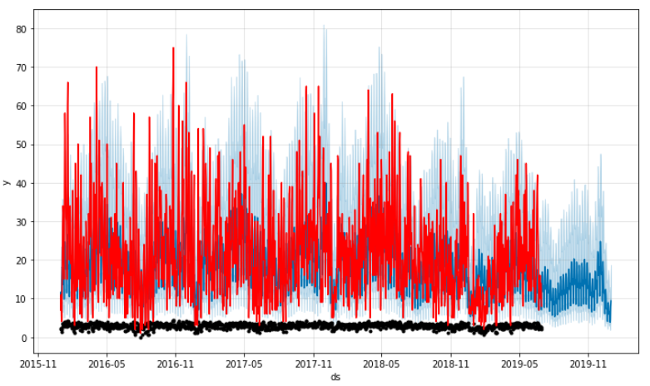
Analysis of Data – Prediction (Time Series Model)
8.148010501008311
8.148010501008311
mean_absolute_error 8.148010501008311

Slide 15
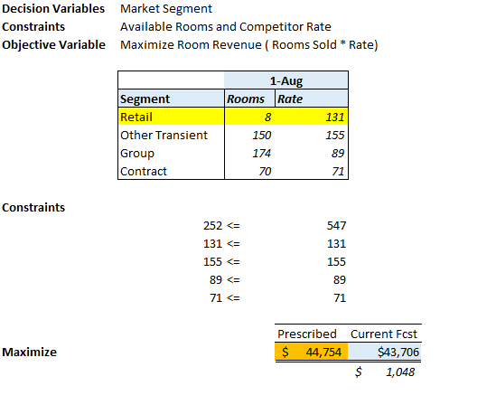
Analysis of Data - Prescription

Slide 16
Challenges and Limitations
Webscraping TripAdvisor data
Fitting ts model
Outliers / missing values / inverse transform
LP Solver – Calculation limit
Assumptions
rate and rooms fixed for other segments
Classic model

Slide 17
Findings
Currently, this particular hotel hasn’t forecasted any rooms for August 1st. If they forecast 8 rooms as predicted by our ts model and sell at a rate of $131 they could add $1,048 per day.

Slide 18
For later…………
Fit holidays and events in the ts model
Use a different program instead of LP solver

